Slide 1
Hui-wen Opac Widget – Deploy
V 2.0

Slide 2
Back-end Files
Must Have:
opac.php
rtac.php
univ.json
File Explanation:
opac.php: Get the real url from Hui-wen OPAC system
rtac.php: Get the RTAC info
univ.json: Set the hui-wen info
index.html: Adding the connection info of Hui-wen OPAC System
add.php: Dependence on index.html. Write the connection info in univ.json

Slide 3
Front-end File
opac.js: connect to back-end, scratch the keyword and replace the data

Slide 4
Deploy – Back-end
As above back-end files put in a directory you want
Adding connection info of the OPAC system in univ.json

Slide 5
univ.json configuration
id: EBSCO ID
appID: Hui-wen or Liberian provide
appKey: Hui-wen or Liberian provide
connectingUrl: The server location
Domain Name/IP + /api/itemgo.php
e.g.: This.is.server.domain.or.IP:port/api/itemgo.php

Slide 6
Deploy – Front-end
Change Parameters:
univAcronym: The university abbreviation
anchorKeyword: The coneection keyword on the EDS page
sid: EBSCO ID
Change AJAX position (If back-end code deploy on local server)
There are two places need a change in this JS

Slide 7
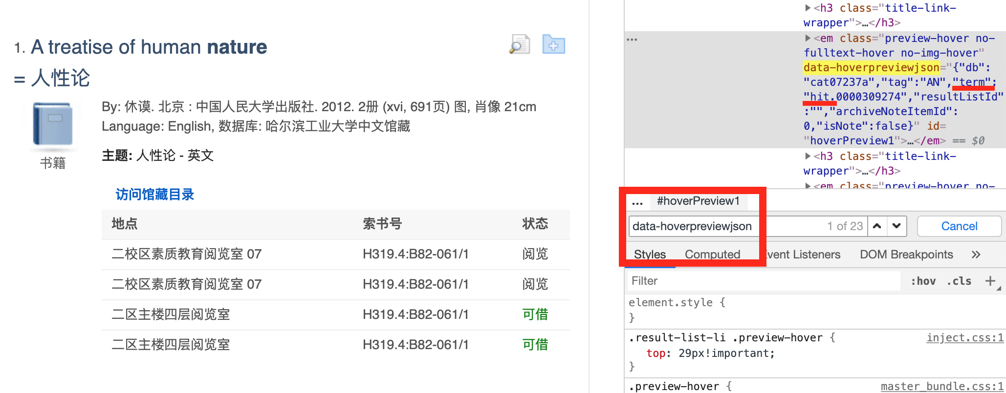
Get Univ Acronym
Search “data-hoverpreviewjson” on your browser (note. This block have to include OPAC info)
Find the “term” and get the abbrivation “hit” as below picture

Slide 8
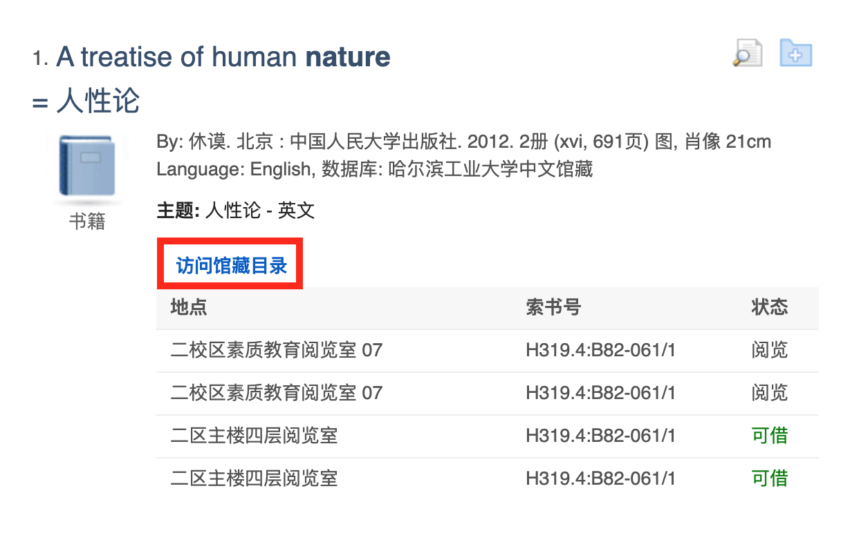
Get anchorKeyword
As picture, this anchorKeyword is “访问馆藏目录”. The keyword is depends on EDS system setting

Slide 9
V 2.0
Add multiple acronym
Sort the status
Add toggle to expand/close the list

